Slide 1
The Real Emitters
What the Data Shows
By Vladimir Estevez,
Christopher Kwok,
Christophe Landry,
& Oni Picotte

Slide 2
What is the problem?
Are statistic by capita model fair?
Are we putting the right effort at the right place?
Can we remodel the data to show us where to focus?

Slide 3
Methodology
Extraction of the output of the energy combustion industry.
Comparing the National & the selected sector emissions level.
Subtracting the emissions of the sector for a more accurate representation.

Slide 4
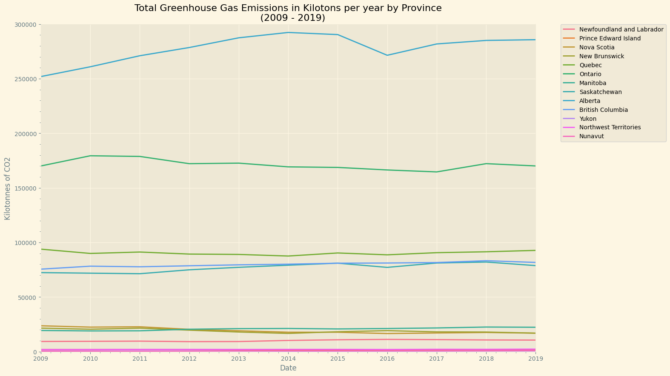
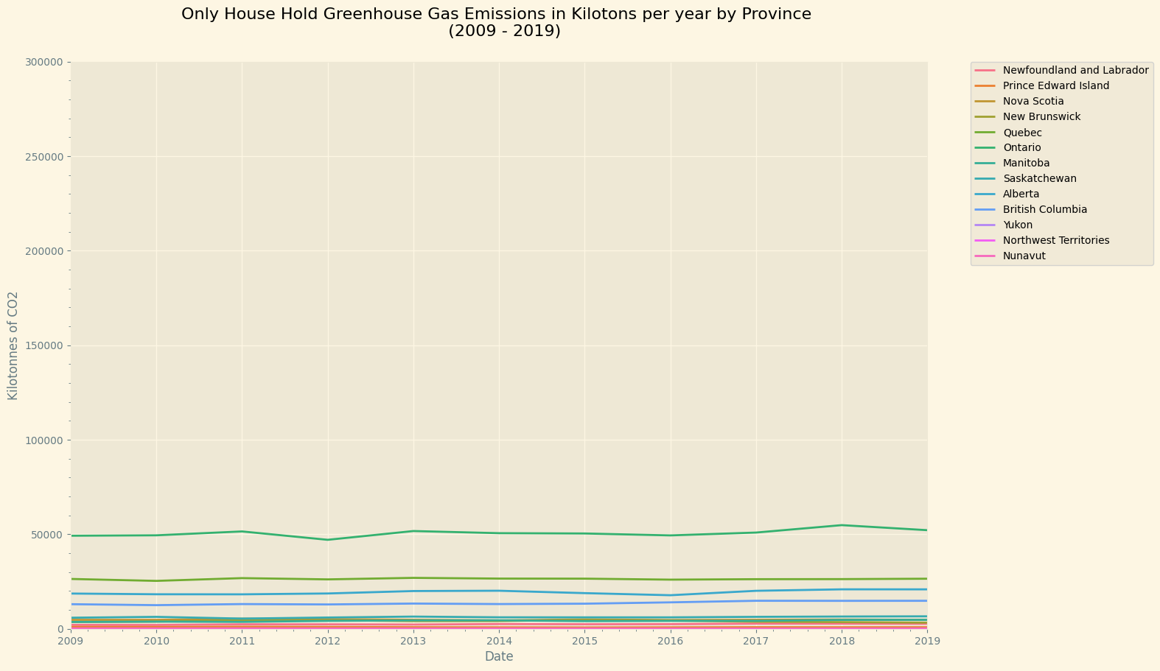
Results

Slide 5
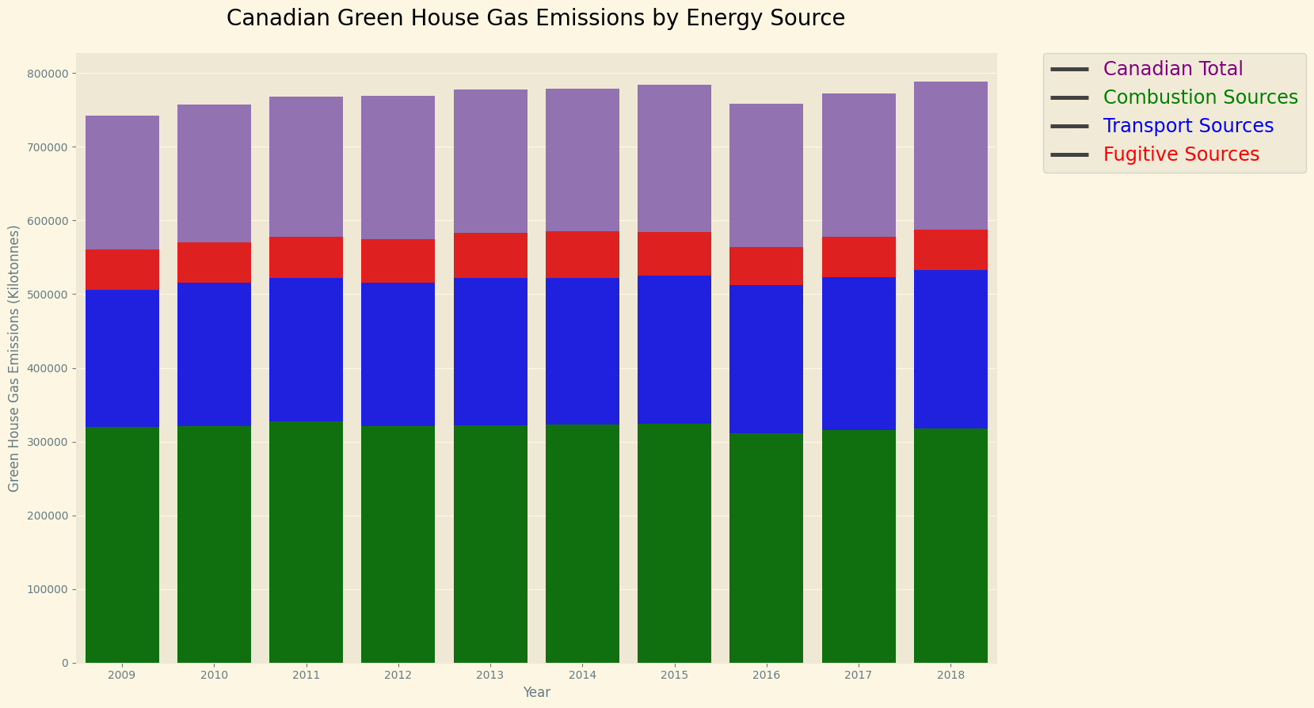
Results

Slide 6
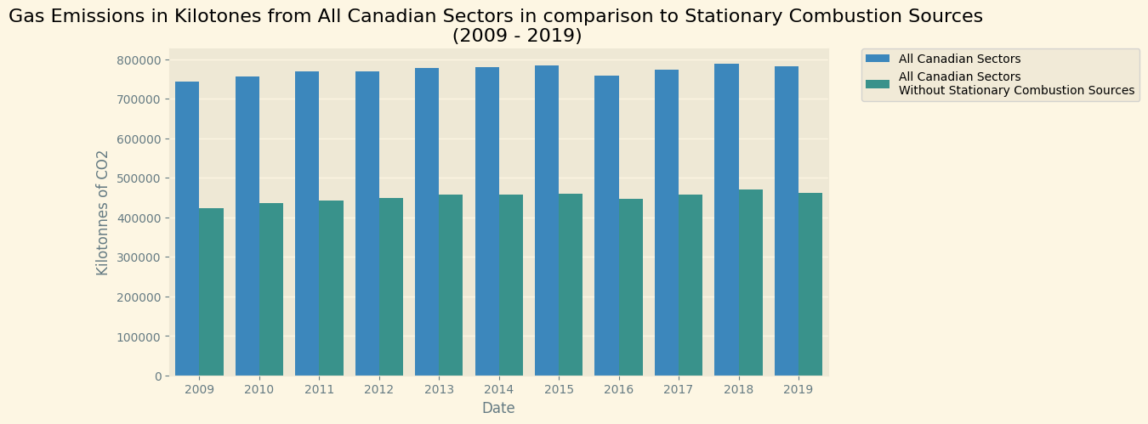
Results

Slide 7
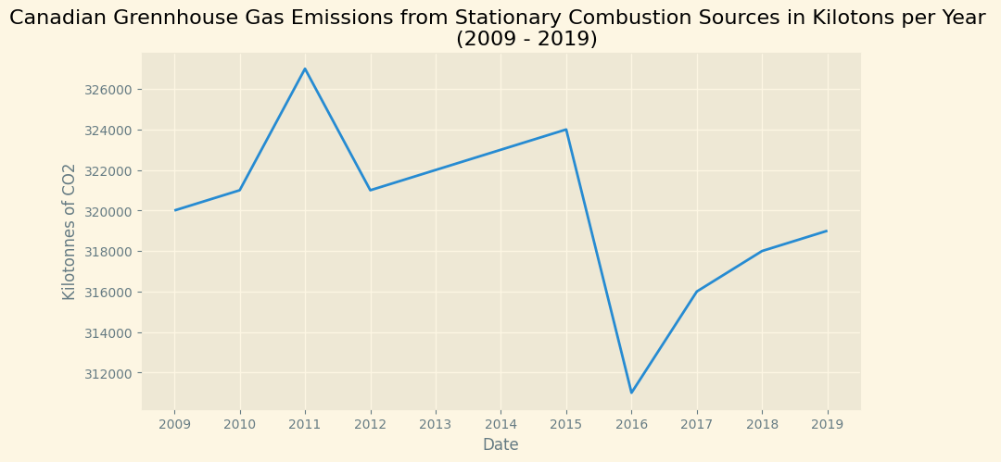
Results

Slide 8
Recommendations
Push the environmental debate on change in key industries.
Focus individual efforts on the Government to implement stricter regulation.
Share more information to others about the real emitters.

Slide 9
Sources
Environment Canada: National Inventory Report 1990-2019: https://publications.gc.ca/collections/collection_2021/eccc/En81-4-2019-3-eng.pdf
Alberta Government: Crude Oil Price per barrel: https://economicdashboard.alberta.ca/oilprice
Statistic Canada: Physical flow account for greenhouse gas emissions: https://www150.statcan.gc.ca/t1/tbl1/en/tv.action?pid=3810009701&cubeTimeFrame.startYear=2009&cubeTimeFrame.endYear=2019&referencePeriods=20090101%2C20190101

